Slide 1


An AI-Driven Autonomous DevOps Framework for Intelligent Cloud Infrastructure Provisioning and Application Deployment
Batch Number:
Name of the Team Members | Roll Numbers
G. Vibhas Naidu | 23071A67F1
Jagadeeswar Jonnadula | 23071A67F4
K Parvez Alam | 23071A67F5
Y. Uday Bhaskar Reddy | 23071A67K4
Under The Supervision of:
Name: Dr. P Jyothi
Designation: Assistant Professor
Dept. of CSE-(CyS, DS) and AI&DS

Slide 2

Abstract:
Modern software development requires efficient, scalable, and reliable cloud deployment, but developers often face challenges in analyzing application requirements, selecting suitable cloud services, configuring infrastructure, managing CI/CD pipelines, and identifying deployment or runtime failures. This project proposes an AI-Driven Autonomous DevOps Framework for Intelligent Cloud Infrastructure Provisioning and Application Deployment that integrates Artificial Intelligence, Machine Learning, Large Language Models, Natural Language Processing, and cloud automation into a unified platform. The system enables developers to connect external code repositories such as GitHub, after which an ML-based code analysis model analyzes the source code to identify the programming language, framework, dependencies, architecture, and infrastructure requirements. Based on these characteristics, an ML-driven cloud-service recommendation model recommends suitable services and deployment strategies across AWS, Microsoft Azure, and Google Cloud Platform (GCP) by considering application requirements, cost, performance, scalability, and resource utilization. A decision and rule layer allows users to enforce deployment preferences, such as selecting a specific cloud provider or choosing the most cost-effective option.
The framework also incorporates an LLM-based application intelligence module to provide context-specific insights about the codebase, architecture, dependencies, functionality, and deployment requirements. Terraform and cloud provider APIs are used to automatically provision the selected infrastructure and deploy applications through CI/CD pipelines. The system generates an explainable deployment report describing the selected cloud resources, their purpose, configuration, and the reasoning behind deployment decisions. For operational reliability, an ML-based monitoring and anomaly detection model analyzes application and infrastructure metrics and logs to identify abnormal behavior, while an ML-based error classification model identifies deployment and runtime failures and predicts their probable causes. A rule-based automation engine can initiate corrective actions such as application restart, scaling, rollback, or redeployment. By combining Machine Learning, Artificial Intelligence, Natural Language Processing, Infrastructure as Code, and multi-cloud automation, the proposed framework aims to reduce manual DevOps effort, improve deployment reliability, optimize cloud-resource selection, and enable intelligent, autonomous, and explainable application deployment across heterogeneous cloud environments.
Keywords:
Artificial Intelligence, Machine Learning, Cloud Computing, DevOps Automation, Multi-Cloud Deployment, Infrastructure as Code, CI/CD, Anomaly Detection.

Slide 3
CHAPTER-1 Introduction:
1.1 Background of the problem
1. Introduction
Cloud computing and DevOps help developers build, deploy, and manage applications efficiently.
These technologies simplify software development and make application deployment faster.
2. Existing Challenges
Application deployment involves code analysis, dependency checking, cloud service selection, and infrastructure configuration.
Performing these tasks manually requires more time, technical knowledge, and effort.
3. Multi-Cloud Complexity
Deploying applications on AWS, Azure, and GCP involves different services and configurations.
Selecting suitable cloud resources based on cost, performance, scalability, and application requirements is challenging.
4. Proposed Solution and Automation
The framework uses AI and ML to analyze application code, identify dependencies, and recommend suitable cloud platforms and deployment strategies.
Terraform and CI/CD automate infrastructure setup and deployment, while monitoring and error detection improve reliability and cost-effectiveness.

Slide 4
1.2 Need and Relevance
Deployment Challenges:
Application deployment requires code analysis, dependency checking, and infrastructure setup.
Manual deployment takes more time and requires technical knowledge.
2. Multi-Cloud Selection
AWS, Azure, and GCP have different services and configurations.
Selecting suitable cloud services depends on cost, performance, and scalability.
3. AI-Based Automation
AI and ML analyze application code and recommend suitable cloud services.
Terraform and CI/CD pipelines automate infrastructure setup and deployment.
4. Monitoring and Benefits
The framework detects errors and supports restarting, scaling, and rollback.
It reduces manual effort and improves deployment speed, reliability, and cost-effectiveness.

Slide 5
1.3 Problem Statement
Complex and Manual Cloud Resource Selection:
Selecting suitable cloud services requires analysis of application requirements, cost, performance, and scalability.
Comparing services across AWS, Azure, and GCP manually can be difficult and time-consuming.
Lack of Context-Aware Application Assistance:
Developers may find it difficult to understand complex codebases, dependencies, architecture, and deployment requirements.
A context-aware system is needed to provide application-specific information through natural-language interaction.
Complex Infrastructure Provisioning and Application Deployment:
Manually configuring cloud infrastructure and deployment pipelines requires significant technical effort.
Automated provisioning and CI/CD-based deployment are needed to simplify the deployment process.
Limited Automated Monitoring and Error Handling:
Applications may experience abnormal behavior, deployment failures, runtime errors, and resource-related problems.
An integrated system is needed to detect anomalies, classify errors, and support corrective actions.

Slide 6
1.4 Objectives:
1. Codebase Analysis and Cloud Selection
The framework analyzes application code, programming languages, dependencies, and infrastructure requirements.
It recommends suitable cloud services and deployment strategies across AWS, Azure, and GCP based on cost, performance, and scalability.
2. Context-Aware Question Answering
The framework allows users to ask questions about application code, architecture, dependencies, and functionality.
It provides relevant answers based on the analyzed codebase to help developers understand applications easily.
3. Cloud Provisioning and Deployment
Terraform and cloud APIs are used to provision infrastructure, while CI/CD pipelines automate application deployment.
The framework generates deployment reports explaining the selected cloud services, configurations, and deployment decisions.
4. Monitoring and Error Handling
The framework monitors application performance, analyzes logs, detects unusual activities, and identifies deployment failures.
It supports corrective actions such as restarting, scaling, rollback, and redeployment to improve reliability and reduce manual effort.

Slide 7
1.5 Scope of Work
• Codebase Analysis and Cloud Service Recommendation: Develop a system that analyzes application code and recommends suitable cloud services and deployment strategies.
• Context-Aware Application Assistance: Provide application-specific information through natural-language interaction with an AI-based assistant.
• Automated Cloud Provisioning and Deployment: Automate cloud infrastructure provisioning using Terraform and application deployment through CI/CD pipelines.
• Multi-Cloud Deployment Support: Support application deployment across AWS, Microsoft Azure, and Google Cloud Platform.
• Intelligent Monitoring and Error Response: Monitor applications, detect anomalies and failures, and support corrective actions such as restart, scaling, rollback, and redeployment.
• Explainable DevOps Automation: Generate clear deployment reports explaining selected resources, configurations, and deployment decisions.

Slide 8
1.6 Organization of the Report
Chapter 1 – Introduction
Presents the background of the problem, need and relevance, problem statement, objectives, and scope of the project.
Chapter 2 – Literature Review
Discusses existing research and approaches related to AI-based airport assistance, identifies their limitations, and presents the research gaps addressed by SIPAS.
Chapter 3 – Approach / Design Methodology
Describes the proposed methodology, technical approach, system design, key components, tools, and technologies used to develop SIPAS.

Slide 9
Chapter 2 – LITERATURE REVIEW
2.1 Overview of Existing Work
1. DevOps Automation
Existing systems automate cloud infrastructure setup and application deployment to reduce manual effort.
AI and ML help developers analyze application code and simplify deployment activities.
2. AI-Based Infrastructure Generation
Large Language Models (LLMs) help generate Terraform configurations based on application requirements.
Some approaches focus on secure infrastructure configuration and automated cloud deployment.
3. Monitoring and Error Detection
AIOps-based systems analyze logs, detect unusual activities, and identify application failures.
They also support resource management and automatic recovery from deployment issues.
4. Research Gap and Proposed Work
Most existing approaches focus on individual tasks rather than the complete cloud deployment lifecycle.
Our framework integrates code analysis, cloud selection, application assistance, Terraform, CI/CD, monitoring, and automated error handling into one system.

Slide 10
2.2 Critical Analysis of Literature:
Title of the Paper | Author details and Journal / Conference publishing information | Proposed method used in the paper | Dataset used in the Paper | Advantages of the proposed paper | Research Gap Identified
1. Automatic Root Cause Analysis via Large Language Models for Cloud Incidents | Yinfang Chen et al. — EuroSys ’24, ACM, 2024 | RCACopilot uses incident handlers and an LLM to collect diagnostic data, identify root-cause categories, and generate explanations. | One year of real-world production incidents from Microsoft | Automates RCA and reduces manual investigation effort. | Performance decreases for unseen root causes; depends on incident handlers and troubleshooting knowledge.
2. Security-First Evaluation of Text-to-Terraform: Benchmarking LLMs and SLMs for Secure IaC Generation | F. L. Santos Vargas et al. — arXiv, 2026 | Evaluates LLMs/SLMs for Terraform generation using Checkov and Trivy security scanning. | 17 curated AWS Terraform generation scenarios | Evaluates both Terraform validity and security compliance. | Small scenario set; prompt engineering alone does not ensure secure IaC.
3. Cloud Infrastructure Management in the Age of AI Agents | Zhenning Yang et al. — arXiv:2506.12270, 2025 | Explores LLM-based AI agents using SDKs, CLIs, IaC platforms, and cloud interfaces for infrastructure management. | Preliminary cloud-management task evaluations | Shows potential for automating repetitive cloud-management tasks. | Safety, reliability, scalability, and long-horizon autonomous operations require further research.
4. AIOpsLab: A Holistic Framework for Evaluating AI Agents for Enabling Autonomous Cloud | Chen et al. — 2024 | Provides a framework for evaluating AI agents on cloud incident detection, diagnosis, and resolution tasks. | Cloud incident scenarios and benchmark tasks | Enables systematic evaluation of autonomous cloud agents. | More realistic environments and broader autonomous operations are needed.
5. An Architecture for Model-Based and Intelligent Automation in DevOps | Research paper on intelligent DevOps automation | Uses model-based approaches and intelligent automation to support DevOps processes. | Not specified in the paper | Supports automation and integration of intelligent decision-making in DevOps. | Limited integration of modern LLM-based autonomous cloud operations.

Slide 11
2.2 Critical Analysis of Literature:
Title of the Paper | Author details and Journal / Conference publishing information | Proposed method used in the paper | Dataset used in the Paper | Advantages of the proposed paper | Research Gap Identified
6. Automating Cloud Infrastructure Provisioning with Semantically-Enriched Large Language Models | Research paper on LLM-based cloud provisioning | Uses semantically enriched LLMs to generate and automate cloud infrastructure configurations. | Cloud infrastructure configuration examples | Reduces manual infrastructure configuration effort. | Requires stronger validation, security, and deployment reliability.
7. Generative AI as an Infrastructure Copilot: Automating Infrastructure-as-Code Across the DevSecOps Lifecycle | Research paper on GenAI and DevSecOps | Uses Generative AI as an IaC assistant across development, security, and deployment stages. | IaC/DevSecOps examples | Supports automation throughout the DevSecOps lifecycle. | Security, correctness, and long-term maintainability remain challenges.
8. Deployability-Centric Infrastructure-as-Code Generation: Fail, Learn, Refine, and Succeed through LLM-Empowered DevOps Simulation | Tianyi Zhang, Shidong Pan, Zejun Zhang, Zhenchang Xing, Xiaoyu Sun — 2025 | Uses iterative generation, deployment testing, feedback, and refinement to improve IaC deployability. | DPIaC-Eval: 153 CloudFormation templates covering about 60 AWS services | Focuses on actual deployment success rather than syntax alone. | Generated IaC still has limitations in requirement coverage and security compliance.
9. AI-Driven Cloud Operations: An Architectural Framework and Research Challenges | Shraddhaben R. Gajjar — Future Generation Computer Systems | Proposes a layered architecture connecting observability, context, reasoning, decision-making, automation, and feedback. | Conceptual/reference architecture; no conventional dataset | Provides a structured architecture for AI-driven cloud operations. | Needs real-world deployment and evaluation of autonomous operations.
10. Generative AI for Infrastructure as Code and Cloud-Native DevOps: A Review of Kubernetes Automation, Terraform Generation, Policy Validation, and Configuration Reliability | Dhiraj Kumar — IJNRD, 2026 | Systematic review of GenAI applications in Kubernetes, Terraform, policy validation, and configuration reliability. | Published research studies from the reviewed literature | Provides a broad view of GenAI-based IaC and DevOps research. | Gaps remain in security, benchmarking, cost optimization, multi-cloud portability, and maintainability.

Slide 12
2.2 Critical Analysis of Literature:
Title of the Paper | Author details and Journal / Conference publishing information | Proposed method used in the paper | Dataset used in the Paper | Advantages of the proposed paper | Research Gap Identified
11. Automatic Root Cause Analysis via Large Language Models for Cloud Incidents | Yinfang Chen et al. — EuroSys ’24, ACM, 2024. | RCACopilot uses incident handlers and an LLM to collect diagnostic data, identify root-cause categories, and generate explanations. | One year of real-world production incidents from Microsoft. | Automates RCA and reduces manual investigation effort. | Performance decreases for unseen root causes; depends on incident handlers and troubleshooting knowledge.
12. Security-First Evaluation of Text-to-Terraform: Benchmarking LLMs and SLMs for Secure IaC Generation | F. L. Santos Vargas et al. — arXiv, 2026. | Evaluates LLMs/SLMs for Terraform generation using Checkov and Trivy security scanning. | 17 curated AWS Terraform generation scenarios. | Evaluates both Terraform validity and security compliance. | Small scenario set; prompt engineering alone does not ensure secure IaC.
13. Cloud Infrastructure Management in the Age of AI Agents | Zhenning Yang et al. — arXiv:2506.12270, 2025. | Explores LLM-based AI agents using SDKs, CLIs, IaC platforms, and cloud interfaces for infrastructure management. | Preliminary cloud-management task evaluations. | Shows potential for automating repetitive cloud-management tasks. | Safety, reliability, scalability, and long-horizon autonomous operations require further research.
14. AIOpsLab: A Holistic Framework for Evaluating AI Agents for Enabling Autonomous Cloud | Chen et al. — 2024. | Provides a framework for evaluating AI agents on cloud incident detection, diagnosis, and resolution tasks. | Cloud incident scenarios and benchmark tasks. | Enables systematic evaluation of autonomous cloud agents. | More realistic environments and broader autonomous operations are needed. The framework uses workloads, fault injection, observability and agent-cloud interaction.
15. An Architecture for Model-Based and Intelligent Automation in DevOps | Research paper on intelligent DevOps automation. | Uses model-based approaches and intelligent automation to support DevOps processes. | Not specified in the paper. | Supports automation and integration of intelligent decision-making in DevOps. | Limited integration of modern LLM-based autonomous cloud operations.

Slide 13
2.2 Critical Analysis of Literature:
Title of the Paper | Author details and Journal / Conference publishing information | Proposed method used in the paper | Dataset used in the Paper | Advantages of the proposed paper | Research Gap Identified
16. Building AI Agents for Autonomous Clouds: Challenges and Design Principles | Manish Shetty et al. — ACM Symposium on Cloud Computing (SoCC ’24), 2024. Authors include researchers from Microsoft, UC Berkeley, UIUC, IISc and other institutions. | Proposes AIOpsLab, combining workload generation, fault injection, observability and an agent-cloud interface to evaluate AI agents for cloud operations. | Cloud applications such as SocialNetwork, with workloads and injected faults; telemetry includes logs, metrics and traces. | Provides a modular and standardized environment for building and evaluating autonomous cloud agents. | Existing AIOps approaches lack standardized metrics, realistic workloads and integrated evaluation frameworks.
17. Autonomous Cloud Operations: The Role of AI-Driven DevOps in Self-Healing Infrastructure | Venkata M. Kancherla — IJERET, Vol. 4, Issue 1, 2023, pp. 66–76. | Uses AI-driven DevOps, predictive analytics, anomaly detection, automation and self-healing mechanisms for cloud infrastructure. | Cloud operational data and historical performance data are discussed; specific dataset is not clearly specified. | Reduces manual effort, supports predictive failure detection, resource optimization and continuous learning. | Data quality, integration complexity, security, privacy, trust and transparency remain challenges.
18. An on-premise cloud-native AIOps infrastructure system with workload | S. Zhang, D. Fan, Y. Liu et al. — SoftwareX 34 (2026) 102622, Elsevier. | Develops an on-premise cloud-native AIOps system with real-time monitoring and a lightweight Transformer-based workload forecasting model using feature-wise normalization and a combined loss function. | Kubernetes monitoring data including CPU, memory, network and disk usage at multiple temporal resolutions. | Provides secure on-premise monitoring, scalable metric collection and proactive workload forecasting. | Existing AIOps systems face high cost, integration complexity, limited customization and workload-prediction limitations.
19. Autonomous Multi-Agent AIOps Framework for Cloud-Native DevOps | Peeyush Kumar — Kuwait Journal of Advanced Computer Technology, Vol. 4, Issue 1, 2026. | Combines multiple AI/ML models and agents for failure prediction, anomaly detection, root-cause analysis and automated remediation. | Jenkins/GitHub Actions pipeline logs, Kubernetes event logs and synthetic anomaly datasets for resource spikes, pod failures and build errors. | Enables earlier failure detection, automatic recovery, reduced false alerts and a self-healing DevOps workflow. | Further work is needed on LLM-powered RCA, reinforcement learning and large-scale real-world deployments.

Slide 14
Chapter 3 – Approach / Design Methodology
3.1 Overview of Phase –I Work and Outcomes
Objective 1 – Codebase-Based Decision Making:
Developed an automated code analyzer to identify programming languages, frameworks, dependencies, routes, and Dockerfile settings.
Trained three Random Forest ML models using 1,600 repository profiles to recommend deployment patterns, cloud providers, and compute services.
Implemented monthly cloud-cost estimation to compare deployment options and identify cost-effective solutions.
Added DevSecOps security checks to validate network isolation and detect exposed secrets.
Objective 2 – Context-Aware Application Q&A:
Developed a context-aware AI assistant to answer questions about application code, architecture, and dependencies.
Created a semantic vector store using 384-dimensional embeddings to store source code, decision summaries, and AWS/GCP documentation.
Generated 5–7 diagnostic questions automatically for each codebase to help developers understand application requirements.
Provided AI-generated answers with supporting file names and line numbers for easy verification.

Slide 15
3.2 Refinement of Problem and Objectives based on Feedback
1. Initial Concept
Initially, the idea was to use LLMs to generate Terraform code directly from simple natural-language instructions.
The main aim was to automate cloud infrastructure setup using AI.
2. Existing Problems
AI-generated Terraform code may fail during deployment if proper validation is not performed.
AI may also suggest incorrect cloud services or generate configurations with security issues.
3. Improved Objectives
Use ML to analyze application code and recommend suitable cloud services and deployment methods.
Use security checks to validate configurations and RAG to answer application-related questions with relevant information.
4. Final Improvement
The framework was improved by combining code analysis, ML-based recommendations, security validation, and AI-based assistance.
This approach aims to make cloud deployment more reliable, secure, and easier for developers.

Slide 16
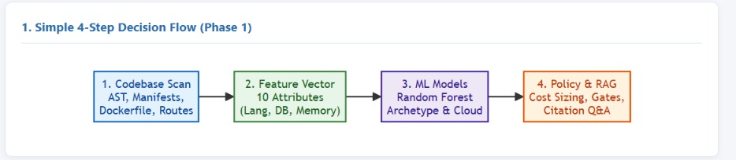
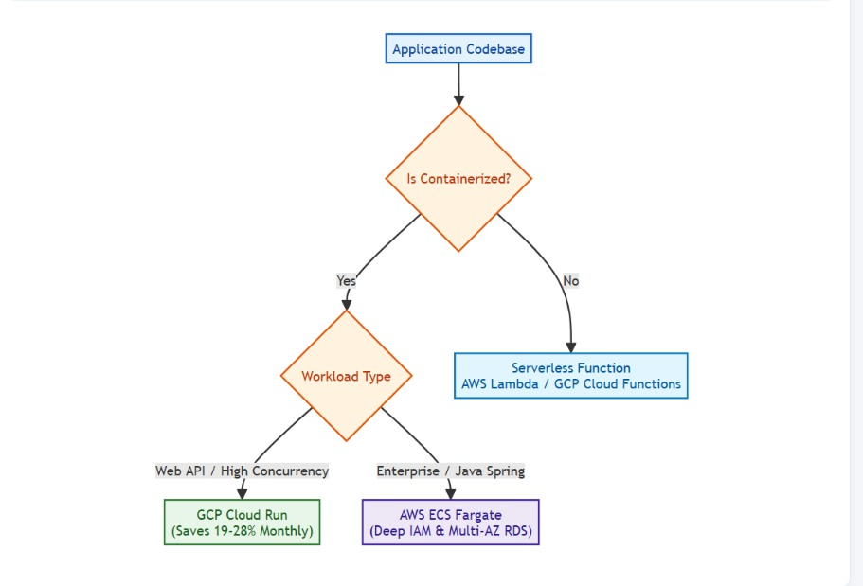
3.3 Selection of Approach / Methodology (Architechture):

Slide 17
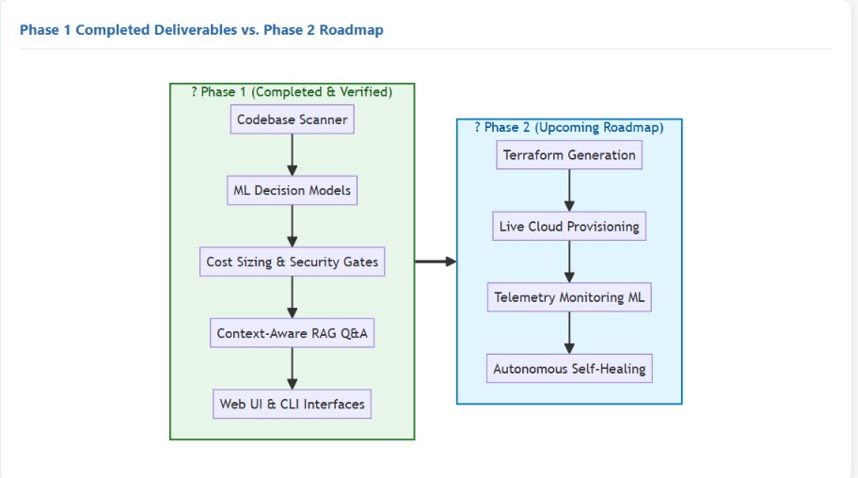
3.3 Selection of Approach / Methodology (Architechture):

Slide 18
3.4 Technical Approach and Key Elements
1. Codebase Scanning and Feature Extraction
The system analyzes application code, dependencies, APIs, and configuration files, then converts the extracted details into a 10-dimensional feature vector to identify application requirements.
2. ML-Based Cloud and Deployment Decisions
Random Forest models recommend deployment strategies, cloud platforms, and compute services, achieving 99.56%, 79.13%, and 100% cross-validation accuracy, respectively.
3. Cost Estimation and Security Validation
The system estimates monthly cloud costs and checks four security gates: packaging, VPC subnets, secret detection, and health probes.
4. Context-Aware RAG Engine
The RAG engine uses all-MiniLM-L6-v2 embeddings to retrieve relevant code and cloud documentation and provide answers with supporting references.

Slide 19
3.5 Supporting Analysis / Design Considerations
• Cloud Service Selection: The system evaluates application requirements such as workload type, scalability, cost, performance, and deployment architecture to select suitable AWS or GCP services.
• Cost Optimization: Cloud deployment options are compared using estimated monthly costs to identify suitable infrastructure while considering application resource requirements.
• Security & Compliance: DevSecOps validation gates are applied to check important infrastructure requirements such as packaging, VPC subnet configuration, secret management, and health probes.
• Application-Specific Decisions: The system does not use a single cloud service for all applications. Recommendations are based on the characteristics of the application, such as containerized workloads, high-concurrency APIs, enterprise applications, and serverless functions.
• Scalability & Reliability: The selected cloud services are evaluated based on their ability to handle application workload, scaling requirements, and availability needs.

Slide 20
3.6 Tools / Techniques Used
Category | Tools / Technologies | Purpose / Usage
Core Language | Python 3.12 | Main programming language used for system development
Machine Learning | scikit-learn 1.5.2, Pandas, NumPy, Joblib | Random Forest models, data processing, feature handling, and model storage
NLP & Semantic RAG | Sentence-Transformers 5.1.2, all-MiniLM-L6-v2, PyTorch, Cosine Similarity | 384-dimensional embeddings, semantic search, and context-aware Q&A
Static Analysis | Python AST, Regular Expressions, XML Parser, JSON Parser, Dockerfile Parser | Codebase scanning, dependency extraction, endpoint detection, and Dockerfile analysis
User Interfaces | Streamlit 1.38.0, Python CLI (argparse) | Interactive web dashboard and command-line interface
Verification | Python unittest | Automated testing and system validation — 7/7 tests passing

Slide 21
3.7 Justification of Selected Approach
• Random Forest for Decision Making: Selected because it handles mixed features well and provides fast and reliable deployment predictions.
• Hybrid ML + Policy Rules: Selected to combine ML-based decisions with fixed security and infrastructure validation rules, reducing unreliable recommendations.
• SentenceTransformers for RAG: Selected because all-MiniLM-L6-v2 is lightweight and provides efficient semantic search for code and cloud documentation.
• RAG-Based Assistance: Selected to provide context-aware and citation-grounded answers using the actual application codebase and relevant documentation.
• AWS + GCP: Selected to compare enterprise-focused AWS services with the container and serverless capabilities of GCP.

Slide 22
THANK YOU

Slide 23
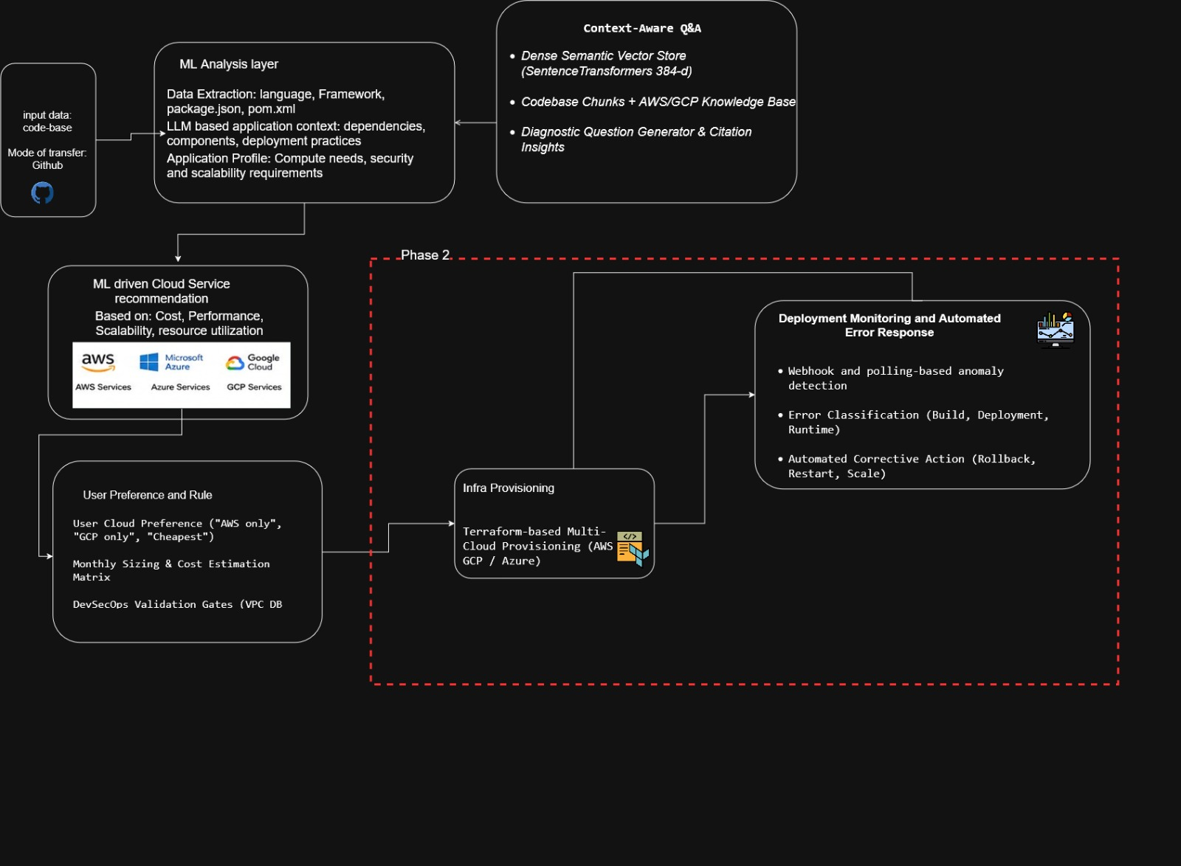
Proposed System Architecture:

Slide 24
Base Paper Link(If any):
https://journals.plos.org/plosone/article?id=10.1371%2Fjournal.pone.0105297&utm_source=chatgpt.com

Slide 25
References:
[1] Humble, J., & Farley, D. (2010). Continuous Delivery: Reliable Software Releases through Build, Test, and Deployment Automation. Addison-Wesley Professional.
[2] Zhang, Q., Fang, C., Xie, Y., et al. (2023). A Survey on Large Language Models for Software Engineering. arXiv:2312.15223.
[3] Hou, X., Zhao, Y., Liu, Y., et al. (2024). Large Language Models for Software Engineering: A Systematic Literature Review. ACM Transactions on Software Engineering and Methodology, 33(8), Article 220.
[4] Patcas, R., & Motogna, S. (2026). An evaluation study of large language models for addressing code quality issues. Empirical Software Engineering, 31, 118.
[5] Abtahi, S. M., & Azim, A. (2025). Augmenting Large Language Models with Static Code Analysis for Automated Code Quality Improvements. arXiv:2506.10330.

